Slide 1
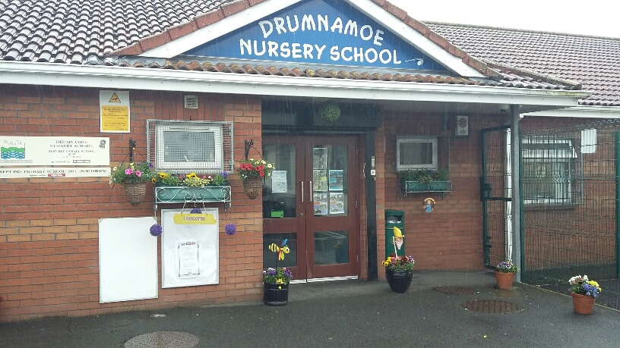
Induction Information
2023- 2024

Slide 2
Meet the Staff
Principal: Mrs E McDonald
Class Teachers: Mrs K Rafferty
Miss L Murray
Nursery Assistants: Lindsey McKenna
Sarah Crossey
Kathryn Kelly
Lisa Thompson
Secretary: Sinead Campbell
Dinner Supervisor : Nicola Greene
Caretaker: Brendan McCann
There is also a Board Of Governors, who govern the school. The Chairperson is Mr Brendan Headley. The rest of the governors are members of our local community.

Slide 3
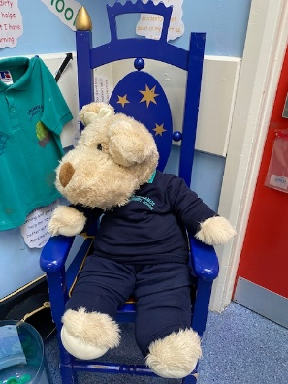
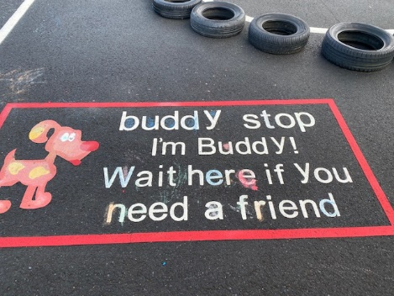
Mission Statement
Drumnamoe Nursery School will provide a quality pre school curriculum, which will take into account the needs of all the children in our care, and the different stages of their development.
A caring environment will be created by a focused and dedicated team, who will work closely with parents at all times, to ensure that all children feel special.

Slide 4
Aims And Ethos
Aims
Work closely with parents/ guardians
Provide a safe/stimulating environment
Encourage the children to develop holistically
Create confident, eager, enthusiastic and independent learners
Be proactive in educational developments
Ethos
To create a happy, harmonious, caring and secure environment
To help the children experience success in all that they do
To instil a sense of belonging and identity in all children as they establish and foster Christian values for life

Slide 5
Keeping In Touch
Parents/ Guardians are kept well informed throughout the year in a variety of ways including:
Monthly electronic newsletters
School website www.drumnamoenurseryschool.com
School text service via Schools NI App
Class Dojo app
Staff available daily at drop off and collection times
Parent/ Guardian meetings
Twitter @Drumnamoens

Slide 6
Visiting Nursery
You and your child will be invited to attend a ‘Stay and Play’ induction visit on one of the following dates:
Tuesday 29th August
Wednesday 30th August
Thursday 31st August
Friday 1st September
Individual date and time to follow.

Slide 7
The Nursery Curriculum
There are 6 areas of development in the Nursery curriculum:
Personal, Social and Emotional Development
Language Development
Mathematical Development
Physical Development
The Arts
World Around Us
The children in Drumnamoe will also be taught Religious Education in accordance with the Catholic Ethos of our School.
We will enhance all educational opportunities by integrating and embedding ICT skills in an age appropriate way.

Slide 8
Important Information
Our school uniform consists of:
Navy tracksuit bottoms
Navy jumper
Winter Emerald Green T- Shirt
Velcro shoes
These items are available from Noel Campbell clothes shop, Lurgan and J & R Fashion, Lurgan.
Please provide a separate labelled bag which is left in school with spare trousers, pants and socks (not a uniform) for accidents that may occur throughout the day.
All children will be expected to put on/ take off their own coat, shoes, jumper, trousers/ skirt and underwear when dressing and undressing for outdoor play, and when using the bathroom independently. Please note that Velcro closing shoes are preferred over lace up shoes.
Your child will need a pair of wellington boots, which will remain in Nursery, to facilitate outdoor play irrespective of the weather.
Please ensure that all of your child’s clothes are clearly marked with their name to avoid any mix up.

Slide 9
Meals and Snacks
Each morning your child will receive a snack and a drink of milk/ water. All snacks are in accordance with the Healthy Eating Policy of our school. Examples of snacks include apples, banana, strawberries, pancakes, toast, yoghurts, crackers, bread sticks etc.
Please inform us if your child has any medical conditions or any medical food allergies so that we can accommodate them during snack and lunch time.
Drumnamoe Nursery School is a cashless school and all dinner/ snack money must be paid through Paypal on a Sunday at the start of each week using our paypal address: drumnamoe_ns@outlook.com
Currently dinner is £2.50 per day - £12.50 per week and snack is £4 per week.
Snack money is used to cover a wide range of activities e.g. parties, gardening, fun days etc. and is therefore £4 per week even if children are off a day or school is closed for a day.
If you think you may be entitled to Free School Meals you must apply online : www.eani.org.uk/financial-help/free-school-meals-uniform-grants/apply-for-free-school-meals-uniform-grants
DO NOT send food or drinks into school along with your child.

Slide 10
How Can I Help My Child At Home?
Share a book with your child every night
Reduce screen-time
Sing songs & nursery rhymes together
Paint or draw a picture
Explore ‘Play Packs’ through Getting Ready to Learn Initiative
Establish and maintain a good bedtime routine
Encourage independence
Have fun together!

Slide 11
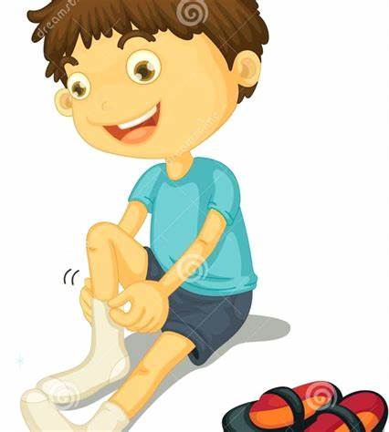
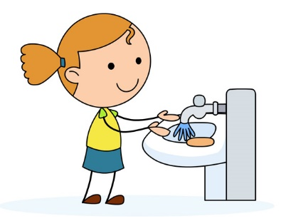
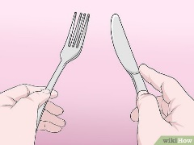
Getting Ready For Nursery
Help your child to be ready for Nursery by making sure they can:
Put on/ take off own coat and shoes
Use the toilet independently
Change own clothes if they have a toileting accident
Wash and dry own hands
Sit at a table for meal times
Use a knife and fork to feed themselves
Begin to share and take turns with others

Slide 12
Child Protection and Pastoral Care
In Drumnamoe Nursery School, the welfare of your child is of paramount importance to us.
All children have the right to :
“ Be protected from all sorts of physical or mental violence, injury or abuse, neglect or negligent treatment, maltreatment or exploitment, including sexual abuse by those looking after them ”
[United Nations Convention 1992]
Designated teacher for child protection in our school is :
E McDonald [Principal]
And deputy designated teachers are Mrs Rafferty / Miss Murray
If you have any concerns regarding any child’s safety/welfare please speak to Mrs McDonald.

Slide 13
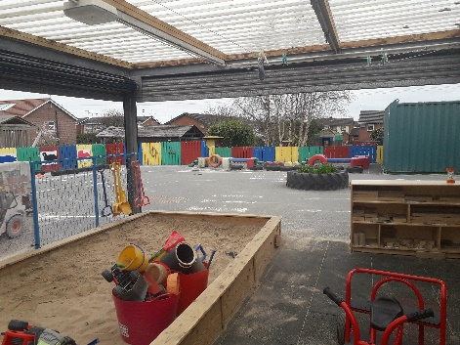
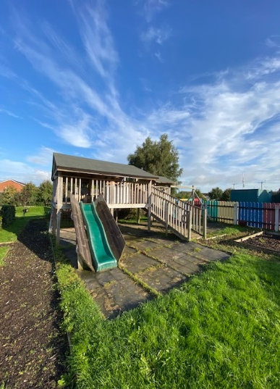
The School Day Full Time Classes
School drop off: 8.45am to 9am
School begins: 9.00am, handwashing routine followed by play.
Meet and Greet: 9.15am
Indoor/ Outdoor Play: 9.25am, including snack
Tidy up time, Language Activities: 11.30am
Lunch Time: 11.45am
Movement Break, Song and Rhyme: 12.15pm
Table Top activities/ Outdoor Play: 12.30pm
Home time Routine: 1.20pm -1.30pm.
Children must be brought to and from school by an adult.
Deliver your child into the care of a member of staff.
Use the designated carpark and park with consideration for other users.
Please collect your child promptly.
Please inform the school when your child is sick and going to be absent.

Slide 14
The School Day Morning Class
Children must be brought to and from school by an adult.
Deliver your child into the care of a member of staff.
Use the designated carpark and park with consideration for other users.
Please collect your child promptly.
Please inform the school when your child is sick and going to be absent.
School drop off: 8.45am to 9am
School begins: 9.00am, handwashing routine followed by play.
Meet and Greet: 9.15am
Indoor/ Outdoor Play: 9.25am, including snack
Tidy up time, Language Activities: 11.15am
Home time Routine: 11.30am

Slide 15
The School Day Afternoon Class
Children must be brought to and from school by an adult.
Deliver your child into the care of a member of staff.
Use the designated carpark and park with consideration for other users.
Please collect your child promptly.
Please inform the school when your child is sick and going to be absent.
School begins: 12.15pm, handwashing routine followed by play.
Meet and Greet: 12.30pm
Indoor/ Outdoor Play: 12.40pm, including snack
Tidy up time, Language Activities: 2.30pm
Home time Routine: 2.45pm

Slide 16
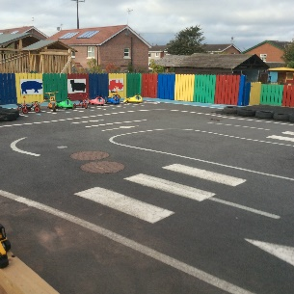
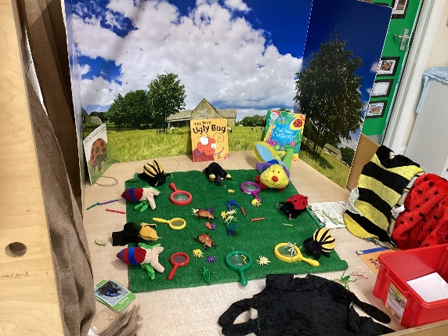
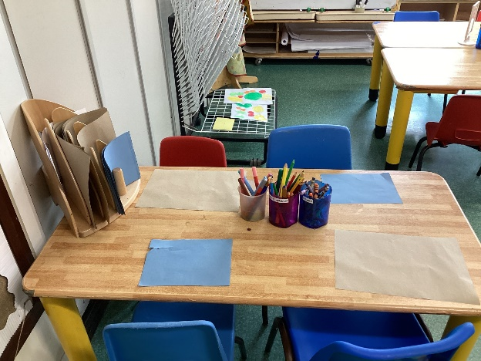
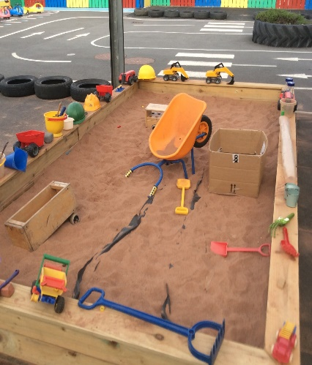
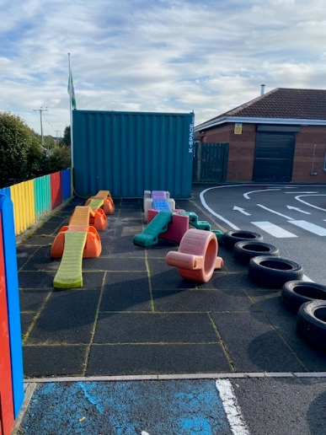
Let’s Have Fun!

Slide 17
See you all soon!

